Slide 1

Welcome to Deep Learning Online Bootcamp
Setting Up TensorFlow

Slide 2

TIP #0
If you don’t have context about Google Colab & Jupyter notebook, please refer optional slides provided about related topics under Day 0
Notes:
What? - CPUs, GPUs, TPUs Why? Where? -

Slide 3
Learning Objectives
CPU, GPU and TPU
GPU Packages for Deep Learning
Setting Up TensorFlow
Importing TensorFlow and checking its version

Slide 4
TIP
You DON’T need to memorize the below jargons!
Notes:
What? - CPUs, GPUs, TPUs Why? Where? -

Slide 5
CPU, GPU and TPU

Slide 6
CPUs
The CPU or Central Processing Unit is the primary component of a computer that processes instructions. It’s called the brain of the computer.
Notes:
What? - CPUs, GPUs, TPUs Why? Where? -

Slide 7
GPUs
GPU stands for graphics processing unit. You'll also see GPUs commonly referred to as graphics cards or video cards. Every PC uses a GPU to render images, video and 2D or 3D animations for display. A GPU performs quick math calculations and frees up the CPU to do other things.
The introduction of GPUs led to the rise of gaming industries and industries that provide high quality visuals. GPUs are not only used in machine learning related work but are also highly useful for content creators, digital artists and gamers.
GPUs play a crucial role while training Deep Learning models. To learn what makes them so important, we would recommend you to go through a very interesting article below that explains why GPUs are necessary for training Deep Learning models:
Why are GPUs necessary for training Deep Learning models?
Notes:
What? - CPUs, GPUs, TPUs Why? Where? -

Slide 8
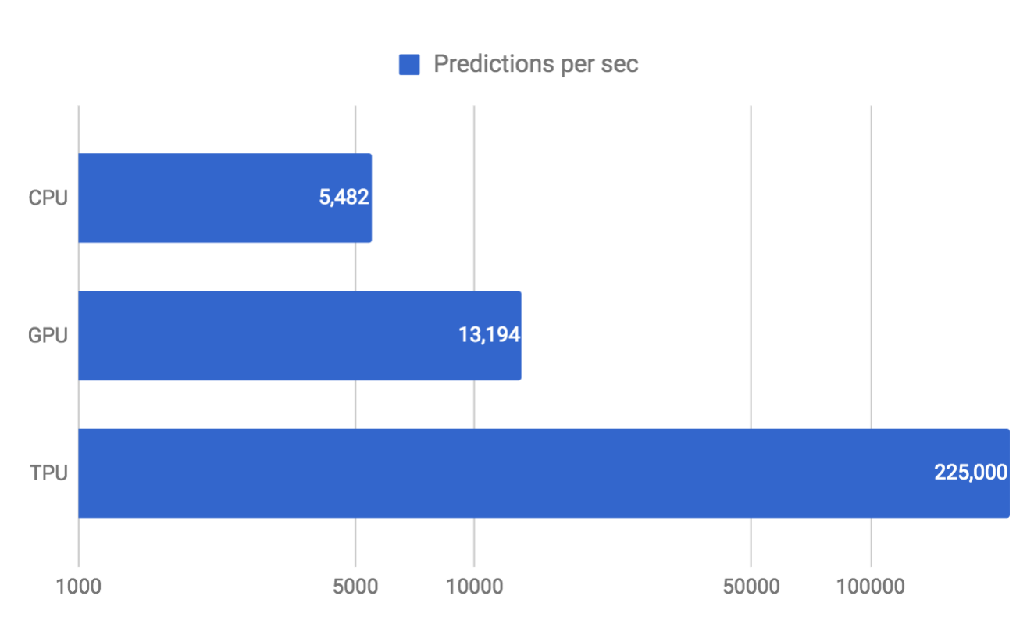
TPUs
Tensor Processing Unit i.e TPU is a designated architecture for DL/ML computation which is designed by Google. It’s not a generic processor, only Tensorflow models can run on it.
If you wish to know more about TPUs, you can read the below article:
https://cloud.google.com/tpu
TPU outperforms CPU and GPU for various Deep Learning models in terms of predictions per second. Source: Sato et al. 2017.

Slide 9
Why GPU and TPU?
CPU can be used to train the model where data is relatively small. The GPUs were introduced as the CPU were slower when dealing with data that contained required huge computations.
In nutshell, GPUs and TPUs are used for reducing the computation time to train efficiently a deep learning model when large datasets need to be processed.

Slide 10
What GPU Packages are required for DL?
For performing Deep Learning operations, 2 GPU Packages are configured while installing TensorFlow. These are:
CUDA:
CUDA is NVIDIA’s language/API for programming on the graphics card. It is one of the easiest ways to write really high performance programs run on the GPU.
You can accelerate deep learning and other compute-intensive apps by taking advantage of CUDA and the parallel processing power of GPUs

Slide 11
What GPU Packages are required for DL?
2. cuDNN: The NVIDIA CUDA Deep Neural Network library (cuDNN)
is a GPU-accelerated library for deep neural networks.
It is built using CUDA and provides GPU accelerated functionality and highly tuned implementations for common operations in deep neural nets.
Deep learning researchers and framework developers worldwide rely on cuDNN for high-performance GPU acceleration. It allows them to focus on training neural networks and developing software applications rather than spending time on low-level GPU performance tuning.

Slide 12
Setting up Tensorflow

Slide 13
Setting up TensorFlow
Option 1: This is a virtual environment that doesn’t need any installation on your device (besides Google Chrome browser).
You just need to go to the following url: http://colab.research.google.com/ and configure your environment to run Deep Learning models
Option 2: Installing Tensorflow on device

Slide 14
Option 1: Google Colab (Virtual Environment - No installation required)

Slide 15
Tensorflow Setup - Google Colab
Google offers Google Colab notebooks (also called as online version of Jupyter notebook) that is easy-to-use and interactive data science environment.
Not just that, Google colab offers you upto 12 GB ram/GPU/TPU etc for free and 100 GB storage.
So, you don’t need to worry about installing a bulky python local application on your laptop/computer
Google colab registration: https://colab.research.google.com/

Slide 16
Tensorflow Setup - Google Colab
Colab gives you a decent GPU for free, which you can continuously run for 12 hours. For most data science folks, this is sufficient to meet their computation needs.
Google Colab gives us three types of runtime for our notebooks:
CPUs,
GPUs, and
TPUs
Why GPU/TPU? In nutshell, GPUs and TPUs are used for reducing the computation time to train efficiently a deep learning model when large datasets need to be processed.

Slide 17
TPUs
Tensor Processing Unit i.e TPUs have been recently added to Google Colab, making it even more attractive for quick-and-dirty machine learning projects when your own local processing units are just not fast enough.

Slide 18
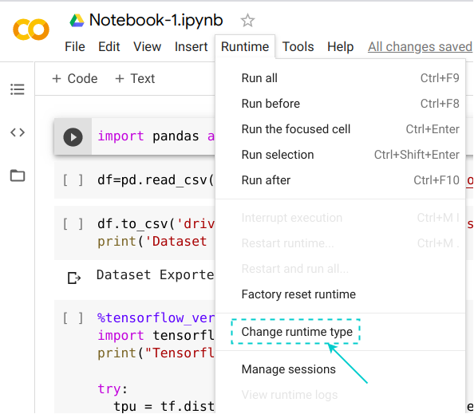
Choosing the GPU or TPU Option
The ability to choose different types of runtimes is what makes Colab so popular and powerful. Here are the steps to change the runtime of your notebook:
STEP 1: Click ‘Runtime’ on the top menu and select ‘Change Runtime Type’:

Slide 19
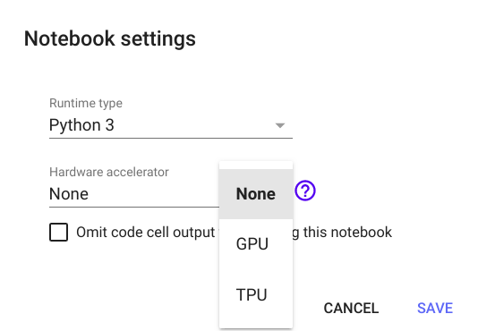
Choosing the GPU or TPU Option
Step 2: Here you can change the runtime according to your need:

Slide 20
To install Tensorflow on Colab
Open your Colab notebook
Type the following command:
!pip install tensorflow
Once the installation is done, run the below command to import tensorflow:
import tensorflow as tf

Slide 21
Option 2: Installing on Device

Slide 22
To install Tensorflow on device
Open your jupyter notebook
Type the following command:
!pip install tensorflow
Once the installation is done, run the below command to import tensorflow:
import tensorflow as tf
A simple video explanation of tensorflow installation can be found on the next slide.

Slide 23

To install Tensorflow on device

Slide 24
Checking the version of TensorFlow

Slide 25
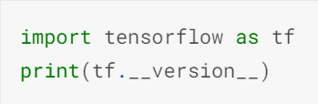
Check the version of Tensorflow
Open a Jupyter Notebook/Google Colab
In a cell type and execute the following command:
Make sure the displayed version starts with 2 i.e ensure Tensorflow 2 has been installed. If not, you can upgrade Tensorflow:
Pip upgrade: https://stackoverflow.com/a/47342614
Conda upgrade: conda upgrade tensorflow-gpu
Google Colab uses TensorFlow 2 by default.

Slide 26
Additional Resources on Installation!
Install Tensorflow GPU on Windows 10 with CUDA and cuDNN
<Intermediate/advanced Learners can explore this option. For rest, we can gradually get there whenever required, for the moment, you can simply go with Google Colab or the device installation mentioned couple of slides earlier>

Slide 27
Download Slides Link
https://docs.google.com/presentation/d/1IvlcSDuUjkEH4XLiqtfSA0rNyhbI5vh-UB84JwqA8BQ/edit#slide=id.g910399512c_25_12

Slide 28
That’s it for this unit. Thank you!
Feel free to post any queries in the #help channel on Slack or on the Discuss forum

